Slide 1
ANDREW XXX vs KENDALL YYY Motor Vehicle Collision – February 8, 2022
Prepared by

Slide 2
PERSONAL DETAILS
Date of birth: May 31, 1991
Gender: Male
SSN number: __________
Current residence: 126 Palm Avenue, Auburndale, FL 33823
Martial status: Single
Spouse ( s): None
Employment status: IT contractor, on site and not working since incident (February 8, 2022)

Slide 3
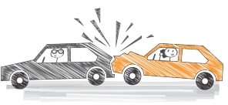
MECHANISM OF INJURY
FACTS: On February 8, 2022, Mr. XXX, a restrained driver, was traveling on a 2-lane highway, 1 lane in each direction. There was a giant TECO truck stopped in front of him waiting to make a left turn.
He was at a complete stop for at least 10 seconds when Kendall YYY rear-ended him at a minimum of 30 mph, likely more. There was nothing he could have done to prevent the incident.
LIABILITY: “Mr. YYY” failed to pay attention to the roadways; carelessly and negligently drove, managed and operated his motor vehicle.
Rear-End Collision

Slide 4
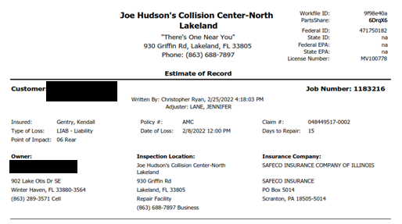
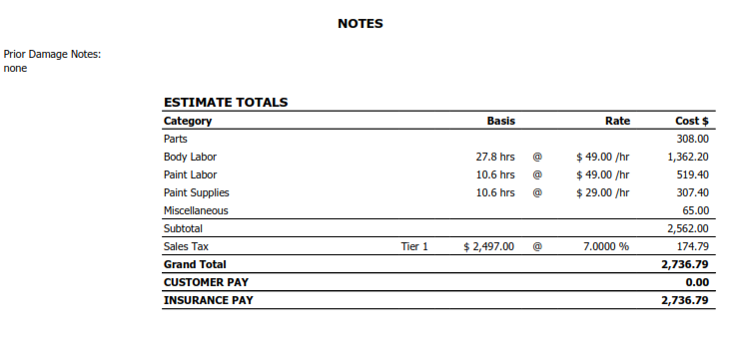
PROPERTY DAMAGES
Inspection Location: Joe Hudson’s Collision Center – North Lakeland, 930 Griffin Road, Lakeland, FL 33805. Repair Facility.
Vehicle details:
2012 Hyun Sonata GLS Automatic 4D SED 4-2.4L Gasoline Direct Injection Dark blue.
VIN: 5NPEB4AC3CH481045
License: 5184QV
State: FL
Exterior color: Dark blue
Production Date: 04/2012
Days to Repair: 15
Estimate total for repair: $2,736.79

Slide 5
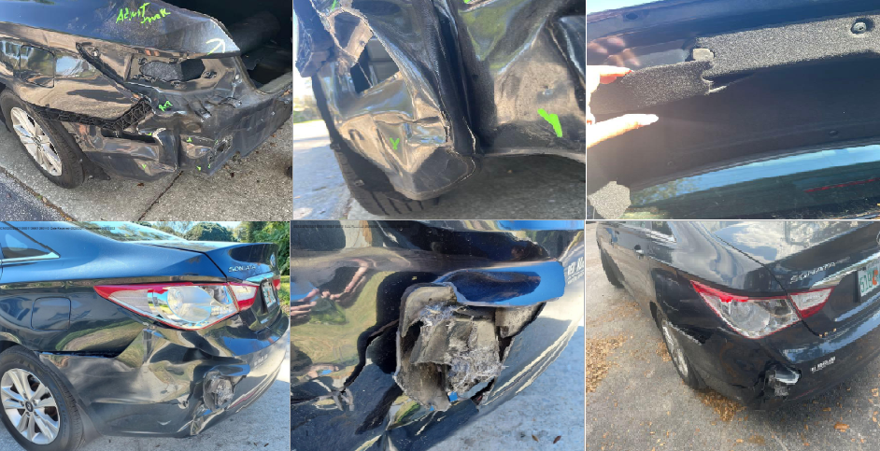
PROPERTY DAMAGES

Slide 6
PROPERTY DAMAGES

Slide 7
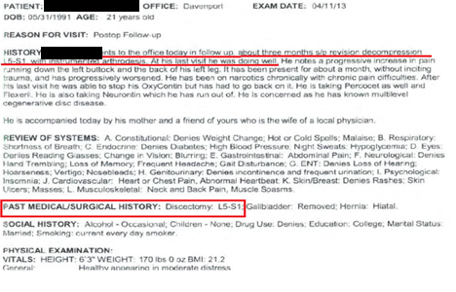
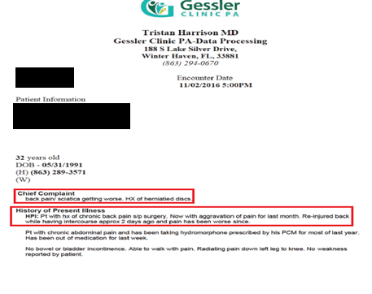
PRE EXISTING INJURIES and TREATMENT
Mr. XXX had a prior history of L5-S1 discectomy surgery approximately 10+ years prior, followed by a L5-S1 fusion surgery approximately 2012.
He did have flares of low back pain after the surgery, with visits in 2016 and 2020.

Slide 8
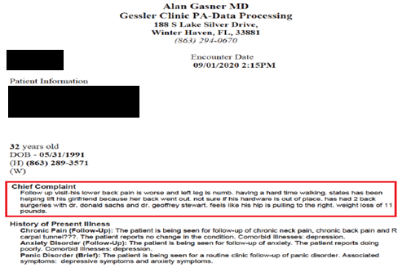
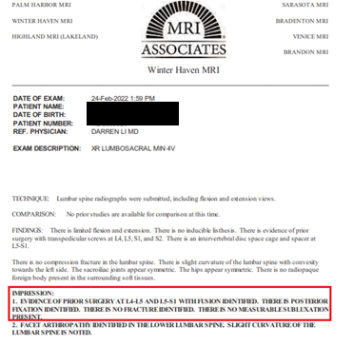
PRE EXISTING INJURIES and TREATMENT
He did have flares of low back pain after the surgery, with visits in 2016 and 2020.
He then reports having a lumbar fusion above at L4-5 level. He reports that his low back pain was “minimal” after the recovery in 2020, and prior to the 02/08/2022 incident.
He states that he had a “full recovery” from the surgery in 2020, was going to gym, lifting weights, doing weighted squats.

Slide 9
SUMMARY OF INJURIES
As a result of motor vehicle accident on February 8, 2022, Mr. XXX sustained the following injuries:
Acute pain (due to trauma)
Lumbar discogenic pain syndrome
Lumbar facet joint syndrome
Lumbar radicular syndrome
Lumbar region radiculopathy
Annular fissure of lumbar disc
Lumbar disc herniation
Bilateral Sacroiliac joint dysfunction
Failed back syndrome
Sacrococcygeal disorders

Slide 10
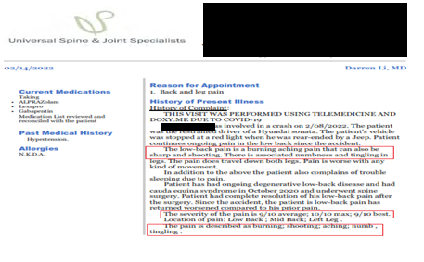
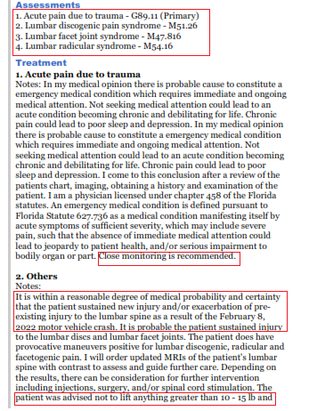
TREATMENT OF INJURIES
Status post the collision, on 02/14/2022, Mr. XXX presented to Darren Li, M.D., at Universal Spine and Joint Specialists for the complaints of sharp, shooting and burning pain in his low back. He reported the severity of his pain level as 10/10.
He was diagnosed with acute pain due to trauma, lumbar discogenic pain syndrome, lumbar facet joint syndrome and lumbar radicular syndrome.
Dr. Li opined that the injuries sustained were either new injury and/or exacerbation of preexisting injury to the lumbar spine as a result of the February 8, 2022 motor vehicle collision.
He was recommended to obtain MRIs of his lumbar spine
He was advised not to lift anything greater than 10-15lbs and to avoid activities that increase the pain level in his back.

Slide 11
TREATMENT OF INJURIES
02/22/2022: MRI of lumbar spine performed at MRI Associates
At L3-4, there is bulging of the disc. There is impression upon the anterior thecal sac. There is mild right-sided and mild left-sided neural foraminal stenosis.
At L4-5, postoperative changes of laminectomy are noted. Artifact from postoperative changes of bilateral pedicle screws and posterior fusion hardware are present. There is bulging of the disc. There is moderate bilateral facet joint hypertrophy. There is moderate right-sided and moderate left-sided neural foraminal stenosis.
At L5-S1, postoperative changes of laminectomy are noted. Artifact from postoperative changes of bilateral pedicle screws and posterior fusion hardware are present. Intervertebral disc spacing device is noted.
02/24/2022: X-ray of lumbosacral spine performed at MRI Associates:
Evidence prior surgery at L4-L5 and L5-S1 with fusion identified. There is posterior fixation identified. There is no fracture identified. There is no measureable subluxation present.
Facet arthropathy identified in the lower lumbar spine. Slight curvature of the lumbar spine is noted

Slide 12
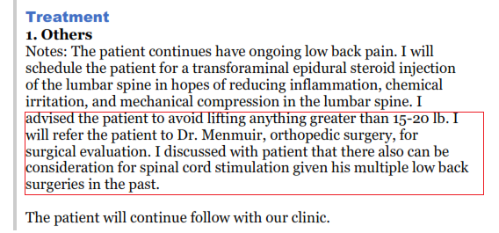
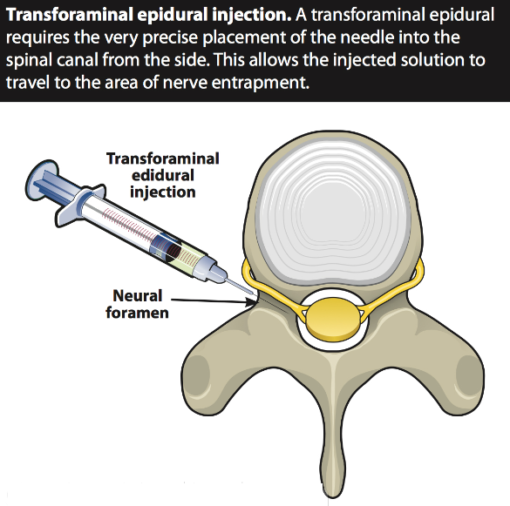
TREATMENT OF INJURIES
02/24/2022: Follow-up visit with Dr. Li at Universal Spine and Joint Specialists:
Received “Lumbar Transforminal Epidural Steroid Injection; Level: L4/5; Side: Right”
He tolerated the procedure well
02/24/2022: Follow-up visit with Dr. Li at Universal Spine and Joint Specialists:
He continued to have ongoing low back pain. He was advised to avoid lifting anything greater than 15-20 lb
He was referred to Dr. Menmuir, orthopedic surgery, for surgical evaluation and consideration of spinal cord stimulation given his multiple low back surgeries in the past

Slide 13
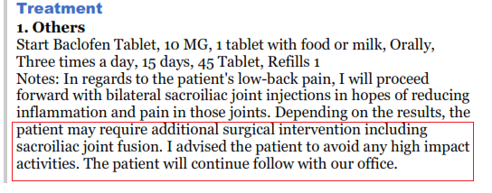
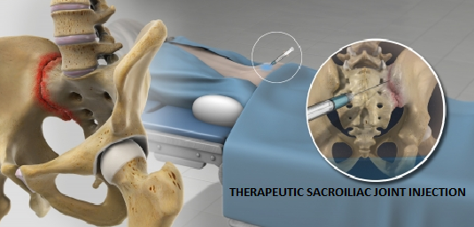
TREATMENT OF INJURIES
03/07/2022: Follow-up visit with Dr. Li at Universal Spine and Joint Specialists:
Received “Therapeutic Sacroiliac Joint Injection”
He tolerated the procedure well
He continued to have ongoing pain in his lumbar spine. He was advised to avoid any high impact activities.
Depending on the injection results, if required additional surgical intervention such as sacroiliac joint fusion would be recommended.

Slide 14
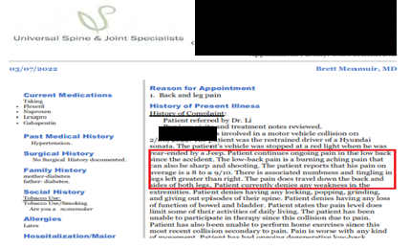
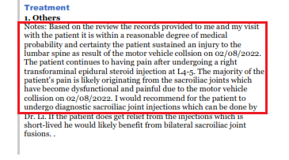
TREATMENT OF INJURIES
03/07/2022: Orthopedic evaluation with Brett Menmuir, M.D. at Universal Spine and Joint specialists
Ongoing pain in his low back since the collision, reported his pain level as 8-9/10.
He is unable to perform home exercises or participate in therapy due to pain
Dr. Menmuir opined that within a reasonable degree of medical probability and certainty the patient sustained an injury to the lumbar spine as result of the motor vehicle collision on 02/08/2022.
The majority of Mr. XXX’s pain originated from the sacroiliac joints which have become dysfunctional and painful due to the collision.
He was recommended to continue to receive therapeutic sacroiliac joint injections with Dr. Li and if no improvement with injections then bilateral sacroiliac joint fusions was advised.

Slide 15
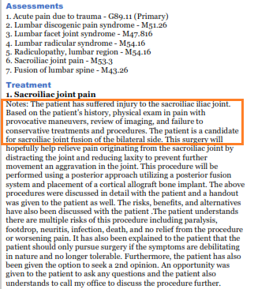
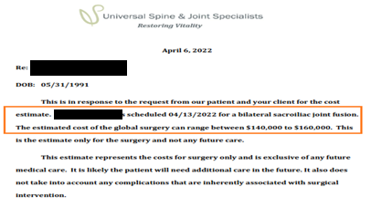
TREATMENT OF INJURIES
03/31/2022: Follow-up visit with Dr. Li
Based on Mr. XXX’s history, physical exam in pain with provocative maneuvers, review of imaging, and failure to conservative treatments and procedures , Dr. Li opined that he was a candidate for sacroiliac joint fusion of the bilateral side.
This surgery would help relieve pain originating from the sacroiliac joint by distracting the joint and reducing laxity to prevent further movement an aggravation in the joint. The procedure to be performed using a posterior approach utilizing a posterior fusion system and placement of a cortical allograft bone implant.
Risks and benefits of the procedure were detailed
04/06/2022: Estimate correspondence by Jay Parekh, D.O.,
Mr. XXX was scheduled for a bilateral sacroiliac joint fusion on 04/13/2022 . The estimated cost of the global surgery can range between $140,000 to $160,000.

Slide 16
TREATMENT OF INJURIES
04/13/2022: Dr. Li performed “BILATERAL ARTHRODESIS OF SACROILIAC JOINT FUSION”

Slide 17
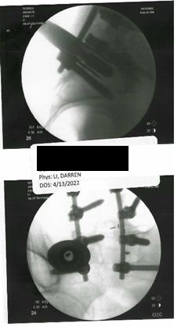
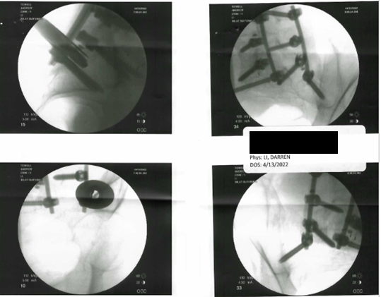
TREATMENT OF INJURIES
04/13/2022: Dr. Li performed “BILATERAL ARTHRODESIS OF SACROILIAC JOINT FUSION”

Slide 18
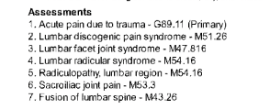
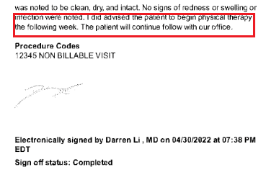
TREATMENT OF INJURIES
04/21/2022: Follow-up visit with Dr. Li
He was diagnosed with the following:
Acute pain due to trauma
Lumbar discogenic pain syndrome
Lumbar facet joint syndrome
Lumbar radicular syndrome
Radiculopathy, lumbar region
Sacroiliac joint pain
Fusion of lumbar spine
04/26/2022: Follow-up visit with Dr. Li
He was advised to receive physical therapy for the following week status post fusion surgery

Slide 19
TREATMENT OF INJURIES
06/01/2022- 07/11/2022: CORA Physical Therapy
He was diagnosed with :
Sacrococcygeal disorders
Treatment received:
Application of hot and cold packs
Therapeutic Exercises
Electrical Stimulation
Therapeutic Exercise
Neuromuscular Re-education
Manual Therapy
Gait Training
FUNCTIONAL STATUS OF MR. XXX AS ON 07/11/2022:
Activity | Current | At Evaluation | Description of current level of function
Walking on even surfaces | Moderate difficulty | Moderate difficulty | Walking about 25 minutes at a time, three times per day
Lifting >5lbs | Maximal difficulty | Maximal difficulty | Carrying with both UE 5-10# with noted increase lumbar pain
Recreational activities | Unable to do | Unable to do | Participates in shooting, anxiety, working out at the gym but has not returned at this point
Balancing | Moderate difficulty | Moderate difficulty | Notices decreased strength overall and feeling stiff and off balance still but not as often

Slide 20
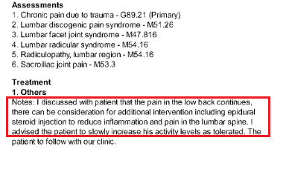
TREATMENT OF INJURIES
07/19/2022: Follow-up visit with Dr. Li:
He continued to have burning and aching pain in his low back.
He was diagnosed with the following:
Chronic pain due to trauma
Lumbar discogenic pain syndrome
Lumbar facet joint syndrome
Lumbar radicular syndrome
Radiculopathy, lumbar region
Sacroiliac joint pain
Dr. Li advised additional intervention including epidural steroid injection to reduce inflammation and pain in the lumbar spine. Mr. XXX was instructed to slowly increase his activity levels as tolerated.

Slide 21
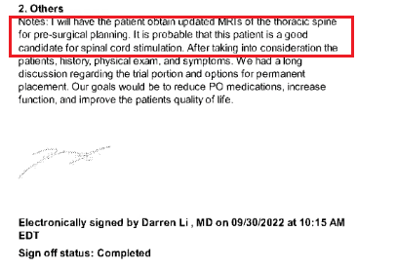
TREATMENT OF INJURIES
09/26/2022: Follow-up visit with Dr. Li:
He continued to have ongoing radicular pain that radiated down to his legs
He was diagnosed with the following
Chronic pain due to trauma
Lumbar discogenic pain syndrome
Lumbar facet joint syndrome
Lumbar radicular syndrome
Radiculopathy, lumbar region
Sacroiliac joint pain
Dr. Li recommended him to obtain MRIs of his thoracic spine for pre-surgical planning to consider him for spinal cord stimulation procedure. The goal of the procedure was to reduce the intake of medications, increase function and improve the quality of life.

Slide 22
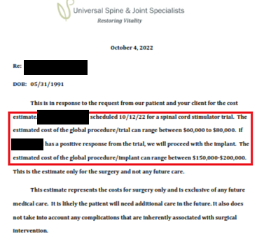
TREATMENT OF INJURIES
10/04/2022: Correspondence of estimate by Chintan Desai, M.D.,:
Mr. XXX was scheduled for a spinal cord stimulator trial on 10/12/2022 . The estimated cost of the global procedure/trial can range between $60,000 to $80,000
In positive response from the trial, it was decided to proceed with the implant at an estimated cost of the global procedure/implant can range between $150,000-$200,000.
10/05/2022: MRI of thoracic spine performed at Advanced Diagnostic Group:
T3-4: Poster central disc herniation/protrusion compressing the thecal sac.

Slide 23
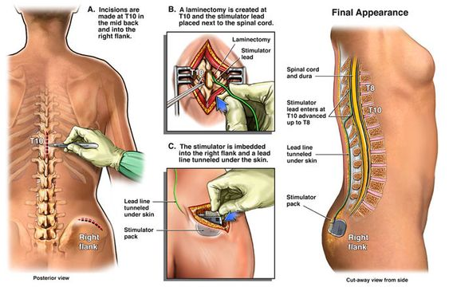
TREATMENT OF INJURIES
10/12/2022: Dr. Li performed “SPINAL CORD STIMULATOR TRIAL LEAD PLACEMENT X 2”

Slide 24
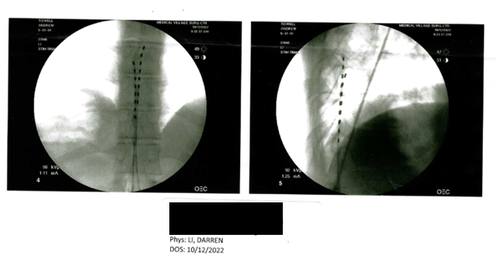
TREATMENT OF INJURIES
He tolerated the procedure well and was advised with the following:
To keep the area dry and not to shower at all during trial phase.
Not to drive, bend lift or twist.
Follow up with office at any time during the trial phase to have the leads removed

Slide 25
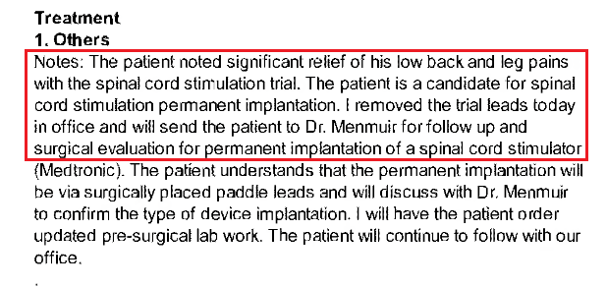
TREATMENT OF INJURIES
10/20/2022: Follow-up visit with Dr. Li
Mr. XXX continued to have ongoing radicular pain radiating down the legs.
Dr. Li removed the trial leads in office and referred him to Dr. Menmuir for follow up and surgical evaluation for permanent implantation of a spinal cord stimulator (Medtronic)

Slide 26
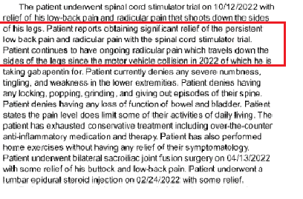
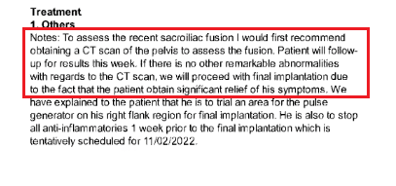
TREATMENT OF INJURIES
10/24/2022: Follow-up visit with Dr. Menmuir
Mr. XXX continued to have ongoing radicular pain radiating down the sides the legs.
The pain level does limit some of his activities of daily living. He had exhausted conservative treatment including over-the-counter anti-inflammatory medication and therapy. He had also performed home exercises without having any relief of their symptomatology.
Dr. Menmuir advised him to obtain CT of his pelvis to assess the recent sacroiliac fusion. It was decided to proceed with the final implantation
He was advised to stop anti inflammatory one week prior to the final implantation which was tentatively scheduled for 11/02/2022

Slide 27
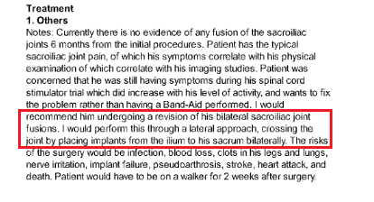
TREATMENT OF INJURIES
10/27/2022: Follow-up visit with Dr. Menmuir
Mr. XXX reported his pain level in his low back as 5-8/10. He had 95% relief in his low back with the sacroiliac joint fusions performed
CT of his pelvis revealed well-healed fusion mass from L4-S1 is noted. No significant spinal stenosis is noted at L3-L4. Left sacroiliac joint fusion device is in the sacral bone outside of the sacroiliac joint. Right sacroiliac joint fusion device is within the sacroiliac joint. No evidence of any fusion is noted bilaterally of the sacroiliac joints.
Dr. Menmuir recommended him to undergo a revision of his bilateral sacroiliac joint fusions through a lateral approach, crossing the joint by placing implants from the ilium to his sacrum bilaterally.
Mr. XXX was advised to use an walker for two weeks after surgery.

Slide 28
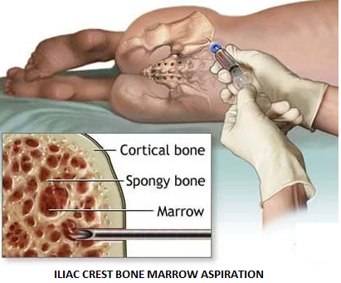
TREATMENT OF INJURIES
11/02/2022: Dr. Menmuir performed “Insertion of autograft bone from iliac crest as well as bone marrow aspiration under fluoroscopic guidance ”

Slide 29
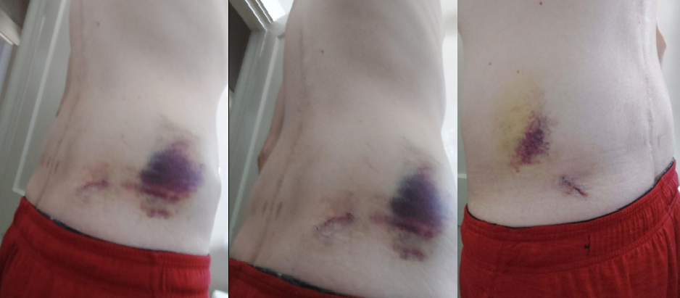
TREATMENT OF INJURIES
11/02/2022: He was advised with the following:
Partially bear weight on the surgical side with crutches for 3 weeks .
Refrain from heavy lifting, bending and driving for 3 weeks.
Apply ice modalities to the surgical sites for 2 weeks.
Not to intake NSAIDs for 12 weeks status post surgery.
Keep the incision dry.

Slide 30
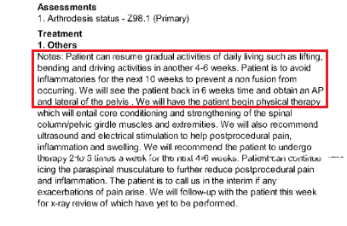
TREATMENT OF INJURIES
11/14/2022: Follow-up visit with Dr. Menmuir
Mr. XXX reported discomfort in his lower back.
Dr. Menmuir advised him to resume gradual activities of daily living such as lifting, bending and driving activities in another 4-6 weeks. He was instructed to avoid inflammatories for the next 10 weeks to prevent a non-fusion from occurring
Dr. Menmuir recommended him to received physical therapy 2 to 3 times a week for the next 4-6 weeks to entail core conditioning and strengthening of the spinal column/pelvic girdle muscles and extremities.
He was advised to obtain X-ray of his pelvis

Slide 31
TREATMENT OF INJURIES
11/16/2022: X-ray of pelvis performed at MRI Associates:
Sacroiliac joint fusion is present bilaterally which has been intervally performed since prior CT of 10/25/2022.
Sclerotic foci are present in the right acetabulum as well as the left iliac bone suspect for areas of bone island formation
No acute osseous abnormality is present
11/16/2022: X-ray of sacrum performed at MRI Associates:
Interval surgery as compared to prior CT of the pelvis of 10/20/2022 in the sacroiliac joints with three fixation pins present in both sacroiliac joints.
Fusion in the lumbar spine is once again present with fixation rods and screws.
Benign bone island formation in the right acetabulum and left iliac bone is present.

Slide 32
TREATMENT OF INJURIES
12/13/2022-01/12/2023: CORA Physical Therapy:
Mr. XXX presented to skilled physical therapy after his second SI joint fusion 11/03/2022 due to his last one was not successful.
He was instructed not bend, lift or twist.
He reported difficulty with bending over to dress, walking prolonged distances and lifting.
Prior to his car accident, he was independent in all activities.
He was off work due to his injuries and worked in IT where he needs to complete sedentary position.
Treatment received:
Application of hot and cold packs
Therapeutic Exercises
Electrical Stimulation
Therapeutic Exercise
Neuromuscular Re-education
Manual Therapy
Gait Training

Slide 33
TREATMENT OF INJURIES
01/16/2023: X-ray of sacroiliac joints performed at MRI Associates:
Evidence of prior lumbar spine surgery with fusion
There is bilateral sacroiliac joint fusion identified with surgical fixation pins identified
Benign bone island in right acetabulum
01/16/2023: MRI of lumbar spine performed at MRI Associates:
Evidence of prior surgery at L4-L5 and L5-S1 with transpedicular screws identified. There is an apparent recurrent disc herniation at L4-L5 centrally. This is unchanged since the prior study of 02/22/2022. There is mild canal stenosis at L4-L5. The neural foramina are patent
Evidence of sacroiliac joint fusion appears to have been intervally performed since the prior study.
L3-L4 diffuse disc bulges identified. There is indentation of the thecal sac with an annular tear centrally. Annular tear is new since the prior examination. There is mild canal stenosis which is unchanged since the prior study. The neural foramina demonstrate no significant narrowing.

Slide 34
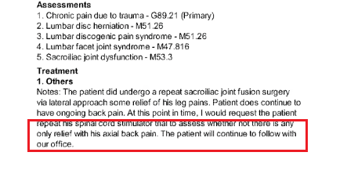
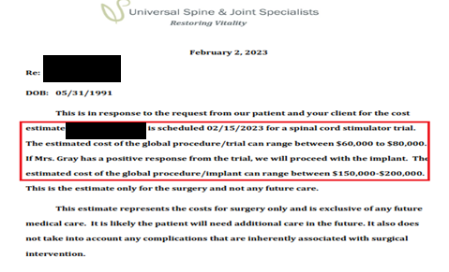
TREATMENT OF INJURIES
01/30/2023: Follow-up visit with Dr. Li
Mr. XXX reported pain in his lower back and imaging evaluation revealed for failure to fuse.
Dr. Li advised him to repeat his spinal cord stimulator trial to assess whether not there was any only relief with his axial back pain
02/02/2023: Correspondence of estimate by Dr. Parekh:
Mr. XXX was scheduled on 02/15/2023 for a spinal cord stimulator trial. The estimated cost of the global procedure/trial can range between $60,000 to $80,000
In positive response from the trial, it was decided to proceed with the implant at an estimated cost of the global procedure/implant can range between $150,000-$200,000.

Slide 35
TREATMENT OF INJURIES
02/15/2023: Dr. Li performed “Spinal Cord Stimulator Trial lead placement x 2; Entry level: L1-2; Lead Position: Left Middle of T8, Right top of T8””
He tolerated the procedure well and was advised with the following:
Keep the area dry.
Refrain from heavy lifting, bending and driving for 3 weeks.
Follow up in two weeks with office at any time during the trial phase to have the leads removed.

Slide 36
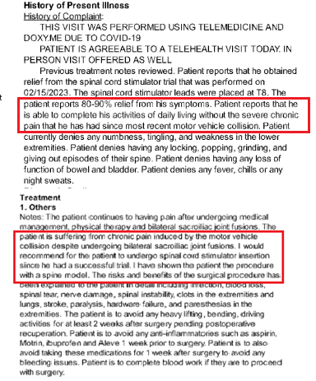
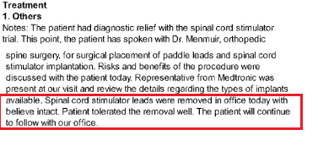
TREATMENT OF INJURIES
02/23/2023: Follow-up visit with Dr. Menmuir
Mr. XXX reported 80-90% relief from his symptoms. He was able to complete his activities of daily living without the severe chronic pain that he has had since the motor vehicle collision.
Dr. Menmuir recommended to undergo spinal cord stimulator insertion since his trial was successful.
02/24/2023: Follow-up visit with Dr. Li:
Dr. Li removed spinal cord stimulator leads in office with intact. He tolerated the removal well and was advised continue to follow-up with office.

Slide 37
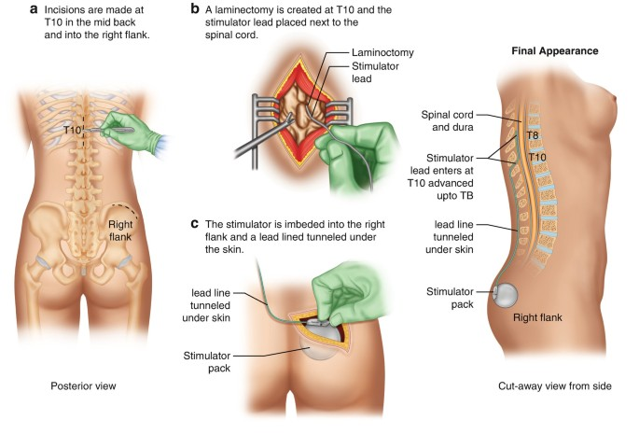
TREATMENT OF INJURIES
03/01/2023: Dr. Menmuir performed the following under fluoroscopic guidance:
Spinal cord stimulator implant paddle at T8-9 and T9-10
Electronic analysis of implanted neuro-stimulator pulse generator
Insertion of neurostimulator pulse generator left generator
Laminectomy T9-10

Slide 38
TREATMENT OF INJURIES
03/01/2023:
He tolerated the procedure well and was advised with the following:
Avoid any heavy lifting or bending activities for the next 4-6 weeks.
Use ice modalities for the next two weeks, 30 minutes on and 30 minutes off,
Avoid anti-inflammatories for the next two weeks to avoid any bleeding issues.
Keep the incision dry for at least five days

Slide 39
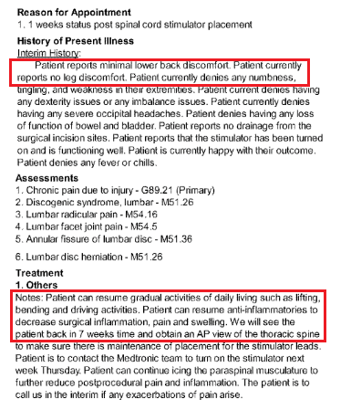
TREATMENT OF INJURIES
03/08/2023: X-ray of thoracic spine performed at MRI Associates:
Spinal stimulator in situ with its tip at the level of body of T8 vertebra
Mild spondylosis thoracic spine
No compression fracture
03/10/2023: Follow-up visit with Dr. Menmuir:
Mr. XXX reported minimal lower back discomfort and no discomfort in his leg.
Dr. Menmuir advised him to resume gradual activities of daily living such as lifting, bending and driving activities
He was advised to resume anti-inflammatories to decrease surgical inflammation, pain and swelling.
He was advised to follow-up in 7 weeks’ time and obtain an AP view of the thoracic spine to evaluate maintenance of placement for the stimulator leads

Slide 40
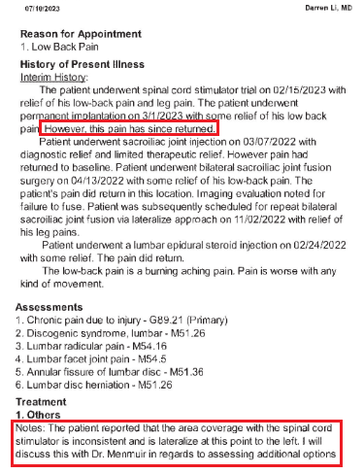
TREATMENT OF INJURIES
07/10/2023: Follow-up visit with Dr. Li
Mr. XXX stated the pain in his low back returned despite the permanent implantation on 03/01/2023.
Dr. Li referred him to Dr. Menmuir to address his concern that the area coverage with the spinal cord stimulator was inconsistent and to lateralize at this point to the left.

Slide 41
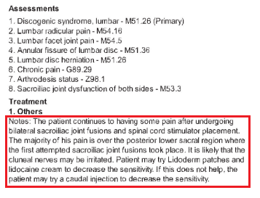
TREATMENT OF INJURIES
07/14/2023: Follow-up visit with Dr. Menmuir:
He continued to have pain despite undergoing bilateral sacroiliac joint fusions and spinal cord stimulator placement.
Dr. Menmuir explained that the majority of his pain was over the posterior lower sacral region where the first attempt of sacroiliac joint fusion was performed. It was likely the cluneal nerves had been irritated.
He was advised to use Lidoderm patches and Lidocaine cream to decrease the sensitivity. If it did not help, he was advised to receive a caudal injection to decrease the sensitivity.

Slide 42
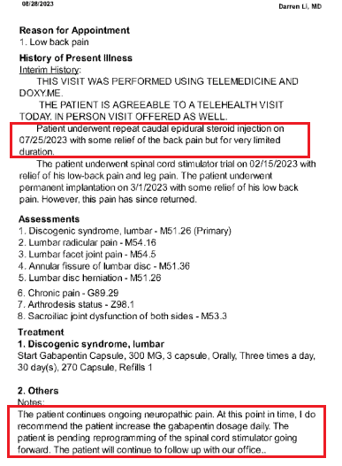
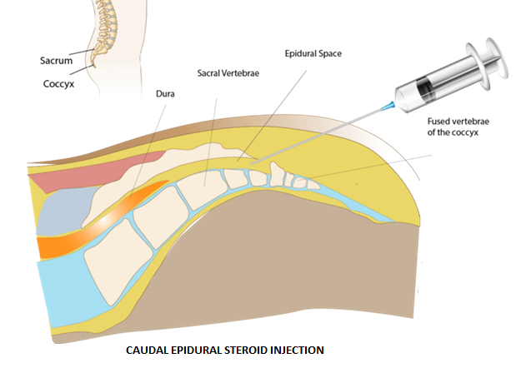
TREATMENT OF INJURIES
07/25/2023: Follow-up visit with Dr. Li:
Received “Caudal Epidural Steroid Injection”
08/28/2023: Follow-up visit with Dr. Li:
He had ongoing neuropathic pain and Dr. Li recommended to increase the dose of Gabapentin. The pending programming of the spinal cord stimulator was advised to be proceeded.

Slide 43
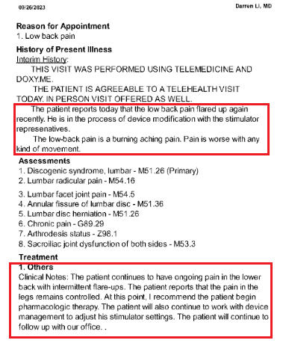
TREATMENT OF INJURIES
09/26/2023: Follow-up visit with Dr. Li:
Mr. XXX reported burning and aching pain in his low back flared up again recently. He was in the process of device modification with the stimulator representatives.
He was diagnosed with the following:
Discogenic syndrome, lumbar
Lumbar radicular pain
Lumbar facet joint pain
Annular fissure of lumbar disc
Lumbar disc herniation
Chronic pain
Arthrodesis status
Sacroiliac joint dysfunction of both sides
Dr. Li recommended to begin pharmacologic therapy. Mr. XXX was advised to continue to work with the device management to adjust his stimulator settings.

Slide 44
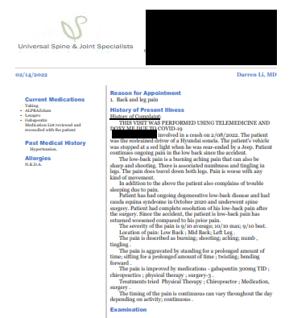
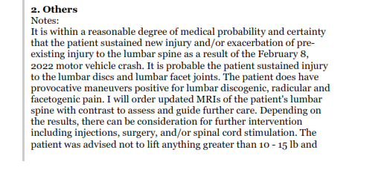
CAUSATION OF INJURIES
As on 02/14/2022, Darren Li, M.D., from Universal Spine and Joint Specialists opined that it was within a reasonable degree of medical probability and certainty that he sustained “new injury and/or exacerbation of preexisting injury to the lumbar spine” as a result of the February 8, 2022, motor vehicle collision.
It was probable that he sustained injury to the lumbar discs and lumbar facet joints and he did have provocative maneuvers positive for lumbar discogenic, radicular and facetogenic pain.

Slide 45
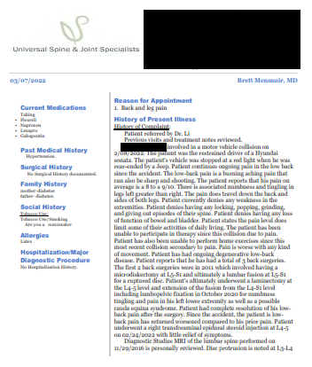
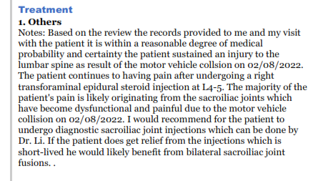
CAUSATION OF INJURIES
As on 03/07/2022, Brett Menmuir, M.D., from Universal Spine and Joint Specialists opined that within a reasonable degree of medical probability and certainty he sustained an injury to the lumbar spine as result of the motor vehicle collision on 02/08/2022.
The majority of the Mr. XXX’s pain complaints were likely originating from the sacroiliac joints which have become dysfunctional and painful due to the motor vehicle collision that occurred on February 8, 2022.

Slide 46
FUTURE MEDICAL TREATMENT
As on 09/07/2023, Steven Barna, M.D., CLCP from LCPMD performed an life care plan evaluation for Mr. XXX.
Present Age: 32 years
Residual Life Expectancy: 49 years
Dr. Barna opined that the subsequent care received by Mr. XXX after the 02/08/2022 collision had been reasonable and necessary.
Dr. Barna stated that the future medical requirements recommended address his diagnoses and consequent disabilities that would adversely impact his vocational activities and quality of life. His opinions within the report were expressed within a reasonable degree of medical and life care planning.
The recommendations were based on a reasonable degree of medical and life care planning certainty to be incurred in the future to manager symptoms, reduce complications/secondary diagnoses, maintain function and foster independence.

Slide 47
FUTURE MEDICAL TREATMENT
Mr. XXX will require:
Office visit on average twice annually with spine physician (i.e. interventional pain physician, spine surgeon) to monitor and manage sacroiliac and spinal cord stimulator related conditions for life expectancy. Also visits with primary care physician (or other chronic pain prescribing physician) for refills of hydrocodone on average quarterly for life expectancy.
Spinal cord stimulator interrogation, programming, on average twice annually for life expectancy and Spinal cord stimulator battery replacement surgery on average every 5-10 years (average every 7.5 years) for life expectancy (beginning 2031).
X-ray sacrum on average annually to monitor implanted sacroiliac hardware for life expectancy
X-ray thoracic spine and lumbar spine on average annually to monitor implanted spinal cord stimulator paddle, wire and battery hardware for life expectancy
Hydrocodone/acetaminophen 5 mg, #90 tablets for exacerbations on average quarterly for life expectancy
Urine drug screen (while on hydrocodone) at least annually for life expectancy
Physical therapy for low back, 12 visits for exacerbations on average every 1-2 years for life expectancy.
The total future medical cost projection for Mr. XXX based on all the information available at the time of the LCP report was: $676,605.00.

Slide 48
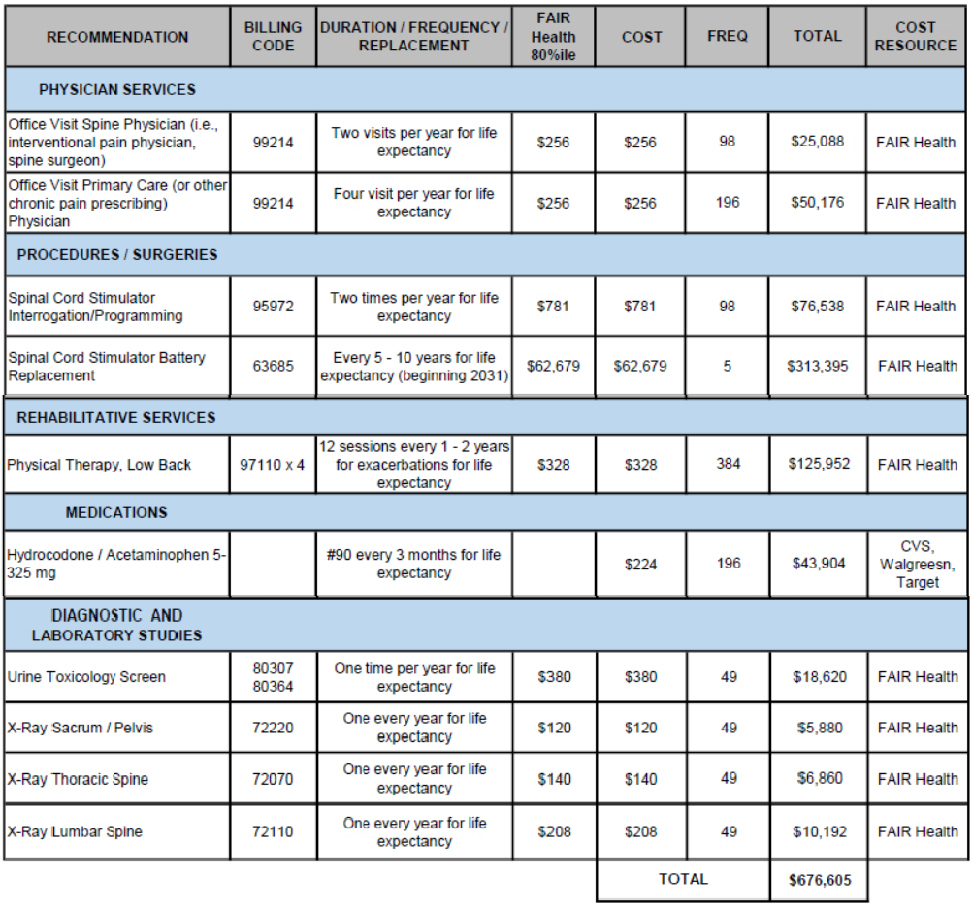
FUTURE MEDICAL EXPENSES

Slide 49
LIFESTYLE IMPACT
As a result of the injuries Mr. XXX sustained in the motor vehicle collision that occurred on February 8, 2022, his life became miserable due to the persistent pain and discomfort that have taken over him.
He had severe pain in his back after the accident. He continues to suffer radiation of radiculopathy pain from his left hip down his left knee despite undergoing surgical interventions to treat his low back.
Due to increased pain he faces difficulties with sitting, walking and standing for prolonged periods. He has trouble sleeping and has to rotate positions frequently. Also, he is unable to bend or lean forward due to pain.
Pursuant to Dr. Li’s recommendations he is restricted to lift anything heavier than a gallon of milk.

Slide 50
LIFESTYLE IMPACT
Further notwithstanding, due to pain and injuries from this collision, Mr. XXX also required assistance with activities of daily living, including, but not limited to:
Service | Source Name | Amount | Dates
Grocery Delivery | Door Dash | Delivery charges undetermined at this time | Ongoing since the collision
Housecleaning | Amy (Unknown last name) | $125.00 | Ongoing once in three months since the collision
Housecleaning | Unknown | $300.00 (approximately) | Ongoing once in three months since the collision
Yardwork | Ruben (Unknown last name) | $100 per month | Ongoing once in three months since the collision

Slide 51
LIFESTYLE IMPACT
With regard to avocational activities, he is unable to enjoy fishing, target shooting, hunting or exercise with weights due to the aggravation of pain in his low back.
Around the year 2020 he had participated in a triathlon and since this collision he is unable to even go for short runs
He feels anxious and depressed with the ongoing pain complaints since the collision.
He was an on-site IT contractor, his job required to travel long distances to the job sites. He is not working since the collision due to the aggravation of pain in his back and legs. He feels his legs were “giving out”.
His physical impairments force him to lead a sedentary life, which will ultimately cause deterioration of his health.

Slide 52
CONCLUSION
Demand is hereby made before the sum of $______.
If this amount exceeds your insured’s policy limits and any applicable excess policies please provide the declaration page. Mr. XXX will be responsible for any and all liens. This policy limit demand shall remain open for 30 days through and including _______

